Slide 1
Restaurant Rating analysis
BY

Slide 2
Who is audience?
Audience for this project or presentation is investors or business man’s who want to invest or start restaurant business. They get understanding about in which area business is performing well.
By this presentation the business man’s or investors will know what category
of consumers are visiting the restaurants.

Slide 3
What’s the data about?
Data of 131 restaurants in Mexico with consumer details
Budget : consumer budget
Rating : rating given by consumers
Transport : mode of transport of consumers
price: restaurant prices
Parking: parking provided by restaurant
Franchise : restaurants belongs to franchise
Age : age of consumers
Cuisine : cuisines offered in restaurants

Slide 4
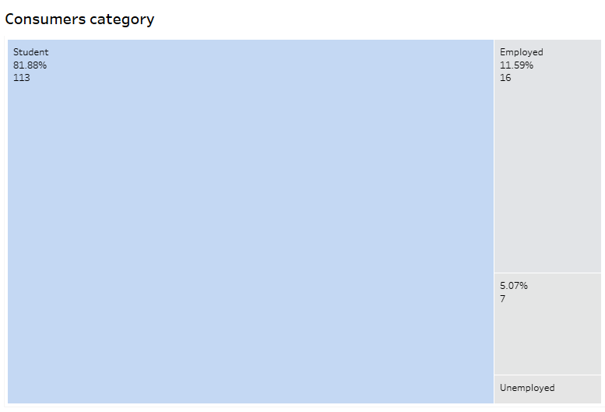
Which category of consumers visiting restaurants ?

Slide 5
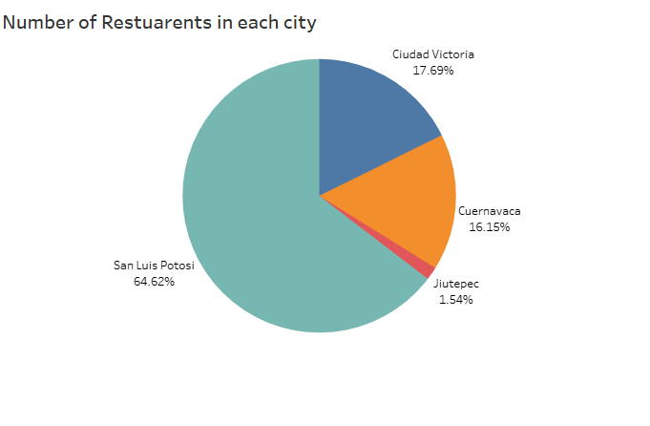
Which city has most restaurants ?
San Luis Potosi city has most number of restaurants.
Jiutepec city has least number of restaurants.

Slide 6
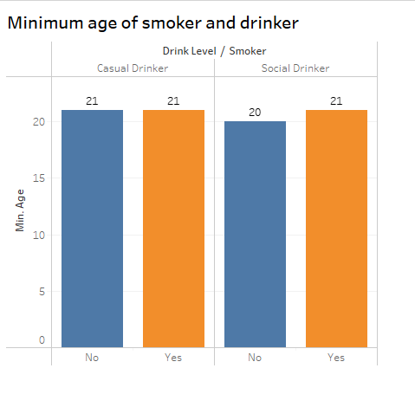

What is the minimum age of smoker and drinker ?
The minimum age of
Casual drinker and
smoker is 21 and
non smoker is 21
The minimum age
Of social drinker is 21and non smoker is 20

Slide 7
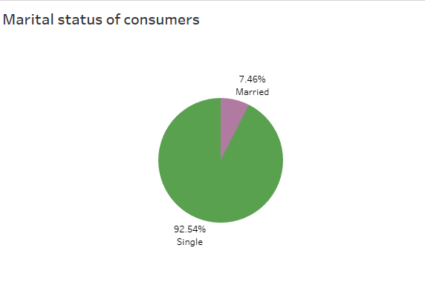

What is the marital status of consumers ?
Most of the consumers
visiting restaurants
are Singles

Slide 8
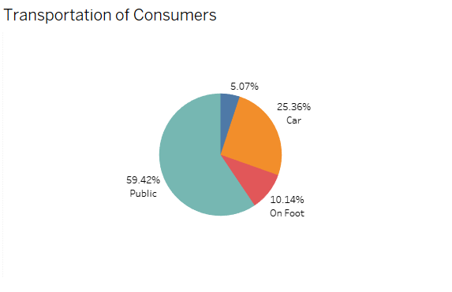
What is the method of transportation of consumers ?
Most of the consumers
Using public transport

Slide 9
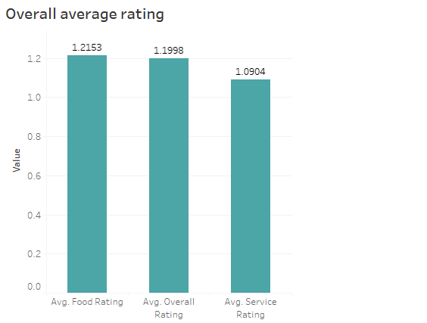
What is the average rating of all restaurants ?
Overall ratings for
all restaurants
Are below 2

Slide 10
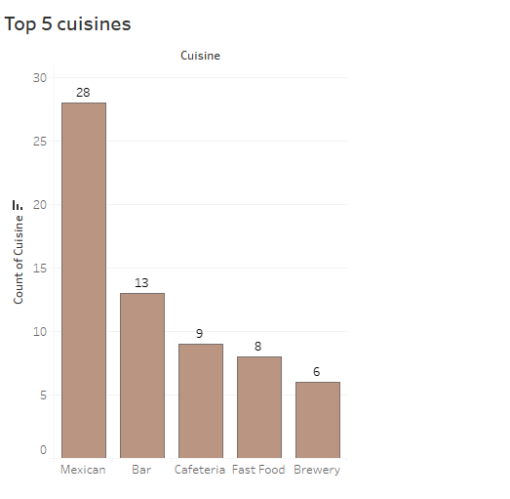
What are the top 5 cuisines ?
Top 5 cuisines preferred
most of the consumers

Slide 11
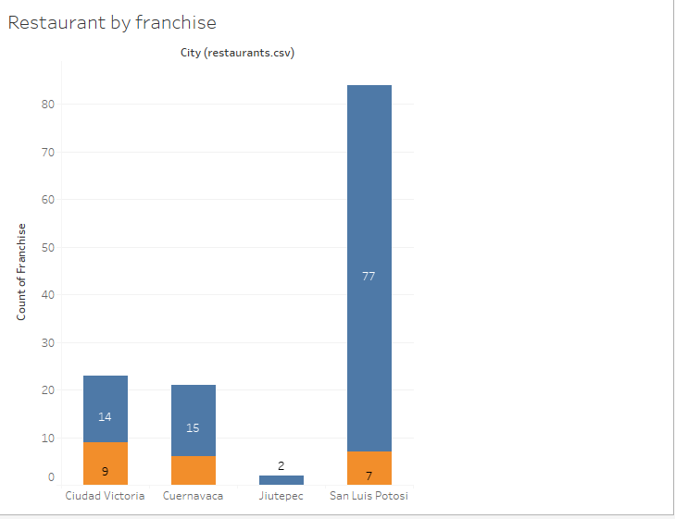

What are the number of restaurants are franchised ?
San Luis city has
most non franchise
restaurants

Slide 12
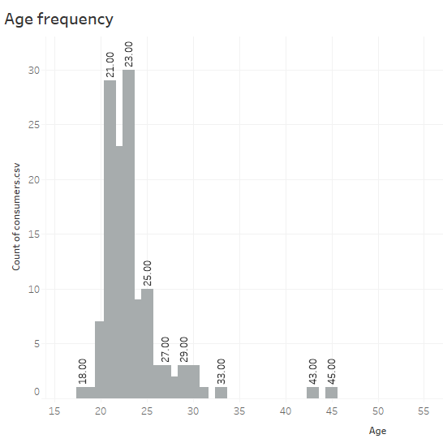
What is most common age of consumers ?
Most consumers are
of age
between 21 and 25

Slide 13
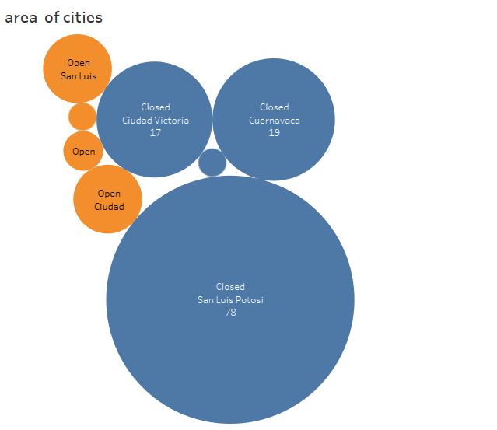
In which are most restaurants are located by each city ?
San Luis city has
Most restaurants in
Closed area

Slide 14
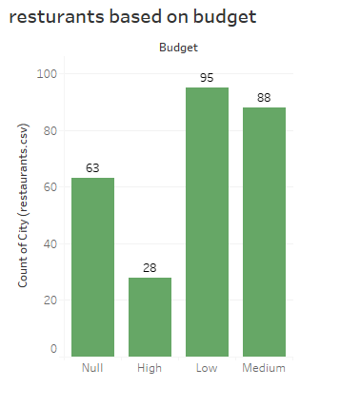
Number of restaurants based on budget ?
Most of the restaurants has
low and medium budget

Slide 15
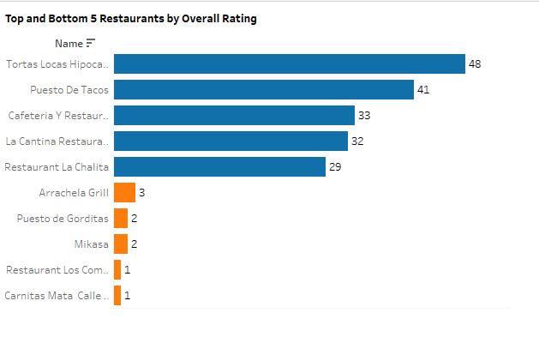
What are the Top and least restaurants by rating ?

Slide 16
Findings
Most of the customers for the restaurants are students.
San Luis Potosi city has most number of restaurants and Jiutepec city has least number of restaurants.
The minimum age of casual drinker and smoker is 21 and non smoker is 21
The minimum age of social drinker is 21 and non smoker is 20
Most number of consumers visiting these restaurants are singles (unmarried).
Almost 60% consumers using public transport to reach restaurants.
Overall ratings for restaurants is below 2 and food rating is more compared to service rating.
Mexican, bar, cafeteria, fast food, brewery these 5 type restaurants has more consumers compared to others
Most franchises are in Ciudad Victoria city and San Luis has most non franchise restaurants.
Most visiting consumers are of age between 21 and 25.
Most of the restaurants are affordable with low and medium budget

